Slide 1
AUTOMATIC IDENTIFICATION AND ANALYSIS OF COMMENTED OUT CODE
Author: Blake Grills
Advisor: Michael Decker

Slide 2
What are the Different Ways to Comment?
Type of Comment | Definition
Line Comment | A single line within source code that has been commented out by means of a line comment marker such as //. Used for both commented-out code and English prose.
Block Comment | Multiple lines within source code that have been commented out by means of a block comment marker such as /* ending with */. Used for both commented-out code and English prose.
#if 0 | Multiple lines of code within source code that have been commented out by means of wrapping the code inside a preprocessor if with a condition of 0. All text/code up until a matching #endif is removed automatically by the preprocessor during compilation. Typically, used to comment out code.
if(0) | While similar to the preprocessor, an if-statement is used, the standard if(0) is processed and compiled by the compiler. This type of block can be rapidly commented and uncommented by changing the 0 to 1 and vice-versa. Can be used to comment-out code.
Doxygen | Used to write software reference documentation, these comments can have hyperlinks and other document wide references. Typically, used to comment out code.
Javadoc | Used to write software reference documentation, these comments have hyperlinks and other document wide references. While similar to Doxygen it is limited to Java languages.

Slide 3
What is Commented-out Code?
// void Print(int res[20][20], int i, int j, int capacity)
// {
// if(i==0 || j==0)
// {
// return;
// }
// if(res[i-1][j]==res[i][j-1])
// {
// if(i<=capacity)
// {
// cout<<i<<" ";
// }
//}
any piece of source code that has been disabled by means of commenting

Slide 4
Gold Set
Comment | File | Block Comment | Language | Contains Code | is Code | Standard Terms
//std::cout<<matlab_format(c_candidate,"c_candidate")<<std::endl; | AABB.cpp | n | C++ | y | y | std::cout, std::endl
//// This doesn't quite make sense to check with bounds | AABB.cpp | n | C++ | n | n
// const Scalar pc_norm = (p-c_candidate).squaredNorm(); | AABB.cpp | n | C++ | y | y | const, scalar
// const Scalar diff = fabs(sqr_d_candidate - pc_norm); | AABB.cpp | n | C++ | y | y | const, scalar
// assert(diff<=1e-10 && "distance should match norm of difference"); | AABB.cpp | n | C++ | y | y
// Actually process elements | AABB.cpp | n | C++ | n | n
// Cheesecake way of hitting element | AABB.cpp | n | C++ | n | n
// Since we only gave ray_mesh_intersect a single face, it will have set | AABB.cpp | (512-513) | C++ | n | n
// any hits to id=0. Set these to this primitive's id | AABB.cpp | (512-513) | C++ | n | n

Slide 5
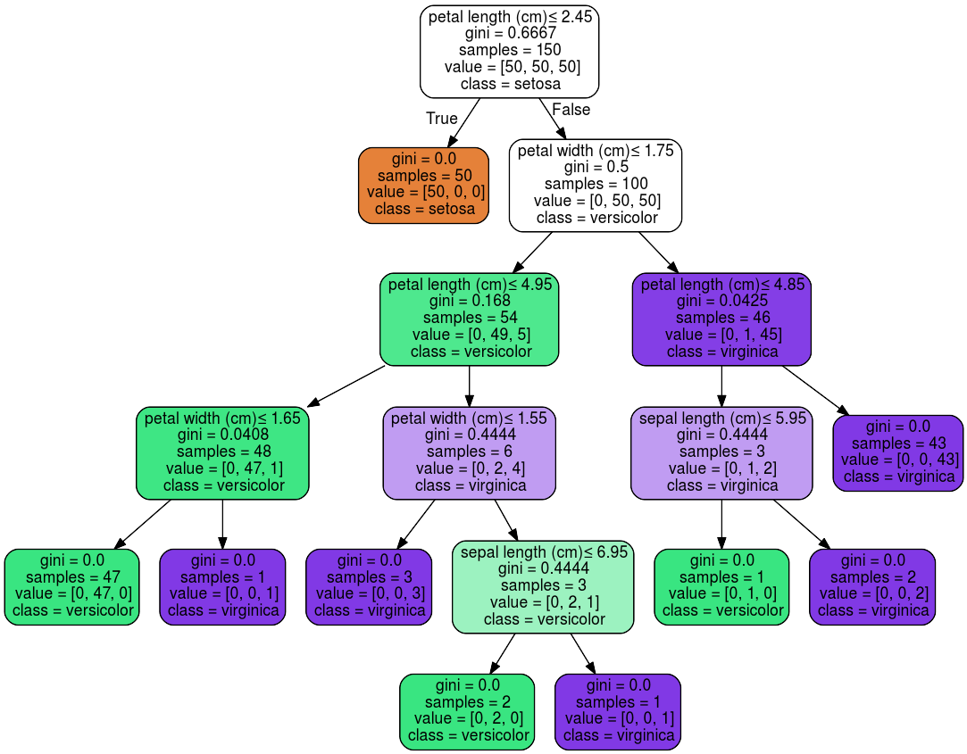
Decision Tree

Slide 6
srcML
Powerful Parsing tool for C, C#, C++, and Java.
Converts source code and comments into XML.
XPATH – Used to query the XML data.
XSLT – used to modify an XML file.

Slide 7
Frequency Based Approach

Slide 8
Frequency Calculation
Symbol | Count | Frequency
A | 1 | .048
Space | 4 | .195
= | 1 | .048
S | 1 | .048
Q | 1 | .048
R | 1 | .048
T | 1 | .048
( | 1 | .048
B | 1 | .048
* | 4 | .195
2 | 2 | .095
C | 1 | .048
) | 1 | .048
//a = sqrt(b**2 + c**2)
Total Characters = 21
Most Frequent Characters = Space, *, 2

Slide 9
Can We Automatically Detect Commented-Out Code With an Acceptable Margin of Error?
Initial Testing
Fold Number | accuracy | precision | recall | F1
1 | 98.50 | 98.15 | 99.07 | 98.60
2 | 97.00 | 100.00 | 94.00 | 96.91
3 | 97.50 | 95.65 | 98.88 | 97.23
4 | 98.50 | 99.00 | 98.02 | 98.51
5 | 98.00 | 99.01 | 97.09 | 98.04
Full Set
accuracy | precision | recall | F1
98.00 | 98.32 | 98.23 | 97.89

Slide 10
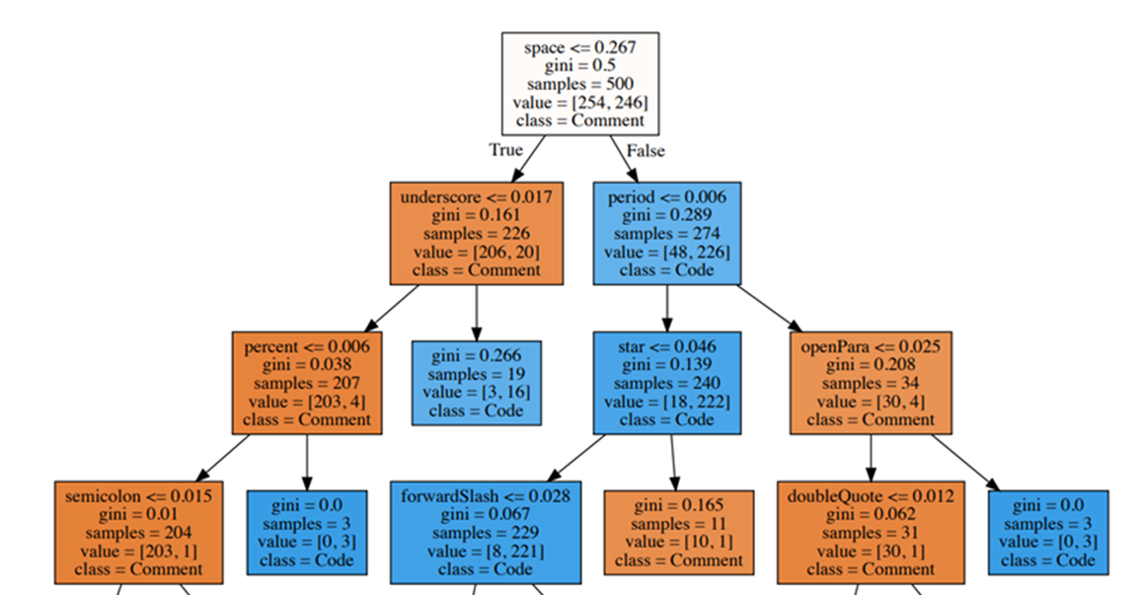
Final Decision Tree Model

Slide 11
How Prevalent is Commented-Out Code in Open-Source Software?
50 Projects Results
accuracy | precision | recall | F1
94.68 | 78.03 | 99.62 | 87.51
50 Projects Additional Data
 | Lines of Comments | Number of Comments | Lines of Commented-out Code | Ratio of comments to Statement LOC | Percentage of Commented-out Code
Total | 2980155 | 1663325 | 176503 | -------------------------- | ---------------------------
Average | 59603.1 | 33266.5 | 3602.102041 | 0.24 | 4.43
Median | 6229 | 3033 | 137 | 0.21 | 2.76

Slide 12
Questions?

